Slide 1
Open Image Dataset Tutorial
Advisor : Jin-Fu Li
Speaker: Yung-Yu Tsai

Slide 2
Outline
Introduction to Open Images Dataset V4
How to download dataset
Google cloud SDK
SDK installation
Download dataset
A training example
Test result

Slide 3
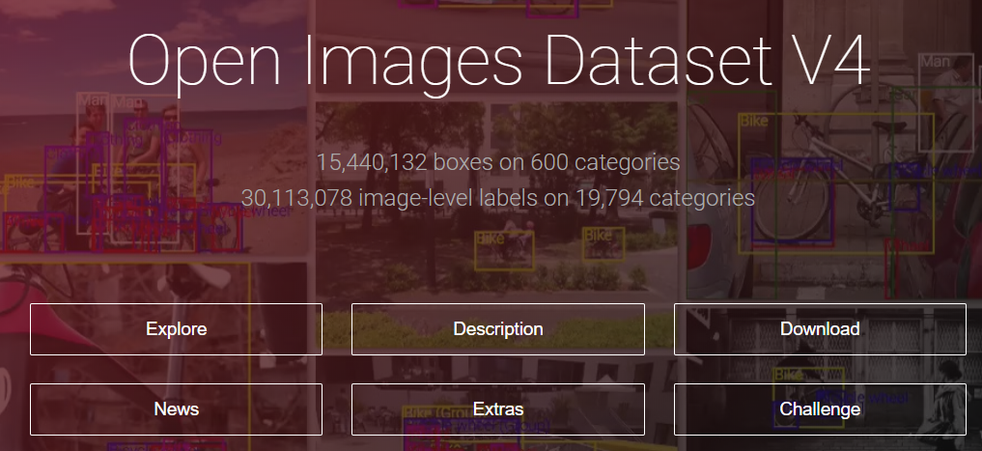
Introduction to Open Images Dataset V4
Website:
https://storage.googleapis.com/openimages/web/index.html
https://github.com/openimages/dataset

Slide 4
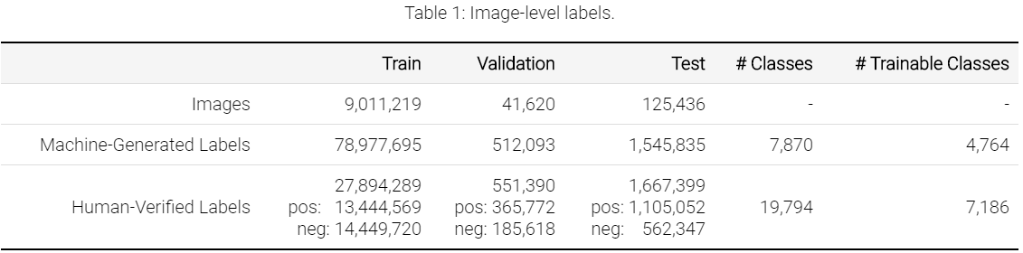
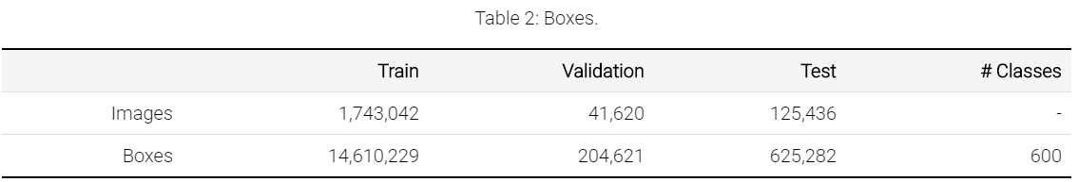
Introduction to Open Images Dataset V4
An open source dataset create by Google.
It contains 9 million image-level labeled images with 7,186 trainable classes.
For bounding boxes, there are 1.7 million images annotated with total 14.7 million bounding boxes which split into 600 classes.

Slide 5
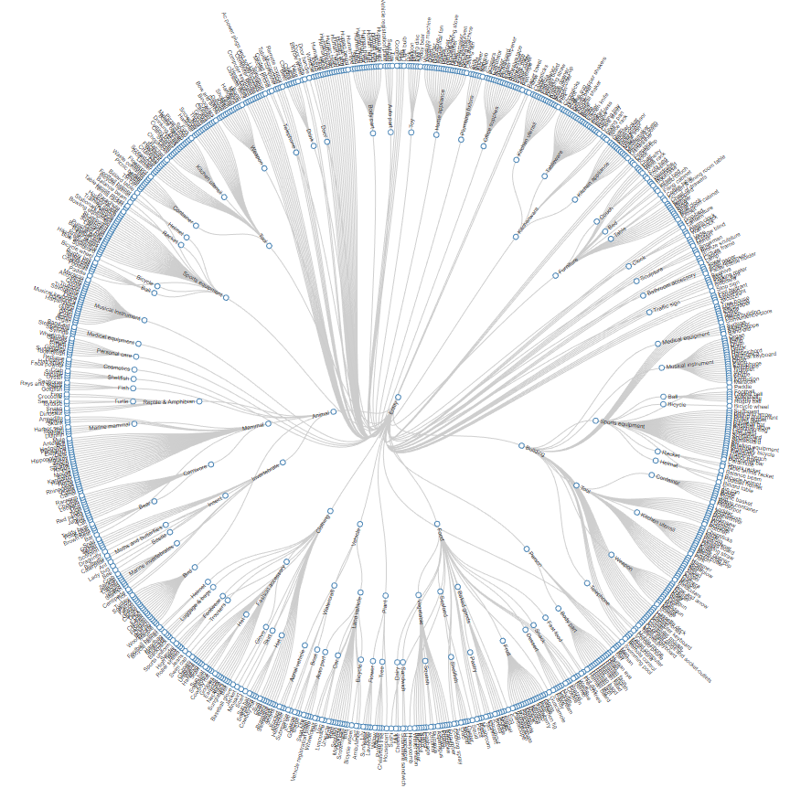
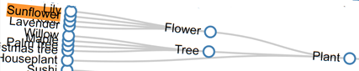
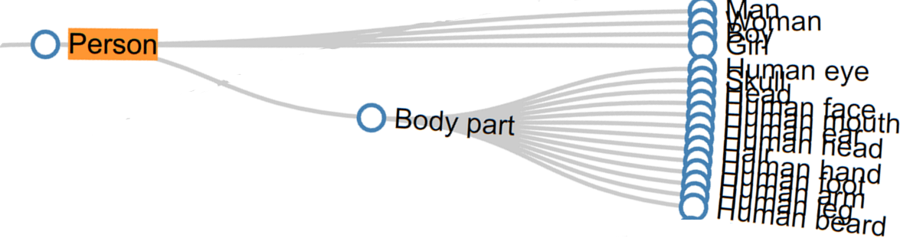
Introduction to Open Images Dataset V4
Class hierarchy for boxable classes
Every class in open image dataset has its correspond code name.
Code name table: https://github.com/openimages/dataset/blob/master/dict.csv
Ex: entity->plant->flower->sunflower
Ex: entity->person

Slide 6
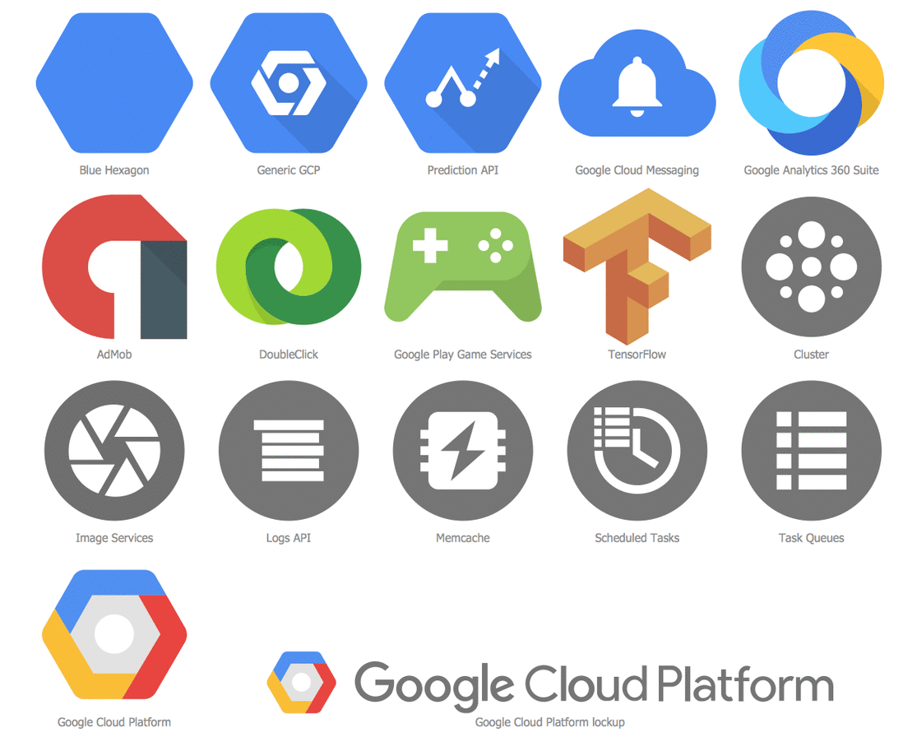
How to download dataset - Google Cloud SDK
Open Image Dataset is stored at Google Cloud Platform.
Use Google Cloud SDK to access it.
A Linux like command line API to program and control your cloud storage.
Uses python 2 as computing language.

Slide 7
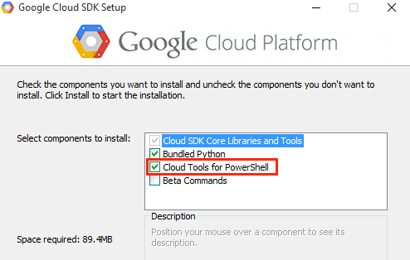
How to download dataset – SDK Installation (1/2)
Installing Google Cloud SDK
https://cloud.google.com/sdk/downloads?authuser=2&hl=zh-tw
https://cloud.google.com/sdk/docs/initializing
Must check the “Bundled Python” and “Cloud Tools for PowerShell” options during installation.

Slide 8
How to download dataset – SDK Installation (2/2)
Follow all the instuction that the installation wizard tell you.
Here is a example of how to install.
https://ephrain.net/gcp-%E4%BD%BF%E7%94%A8-gcloud-%E9%80%A3%E7%B7%9A%E5%88%B0-google-cloud-platform-%E4%B8%8A%E7%9A%84-vm/
Finish the initialization process.
It’s not necessary to start a new cloud platform project, we just need cloud SDK as tool to download dataset.
It is suggested that using NCU G-suite(@g.ncu.edu.tw) account as the cloud SDK account.
https://googleapp.ncu.edu.tw/GoogleApps/
It’s business account with unlimited cloud storage space.

Slide 9
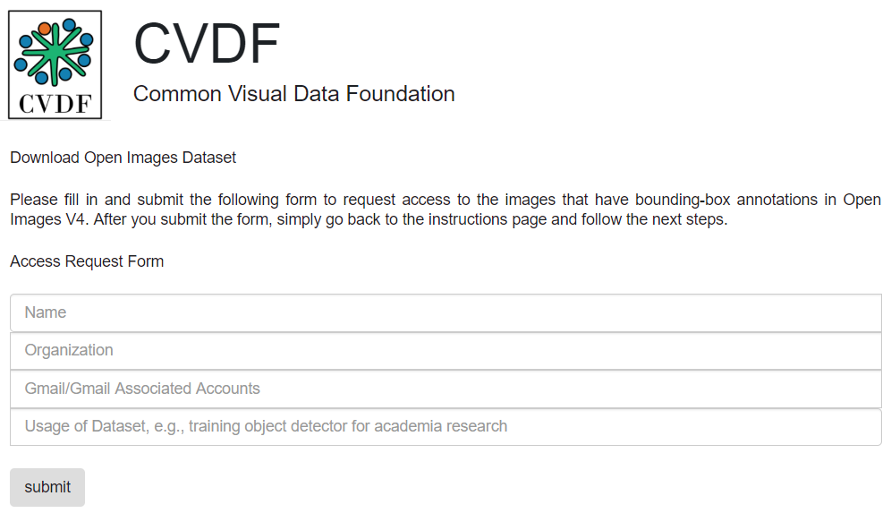
How to download dataset – Download (1/3)
Go to CVDF(common Visual Data Foundation) website.
Apply for usage of open image dataset.
http://www.cvdfoundation.org/datasets/open-images-dataset/signup.html
National Central University
academia research

Slide 10
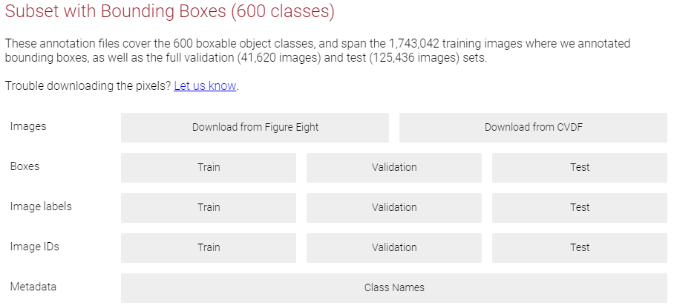
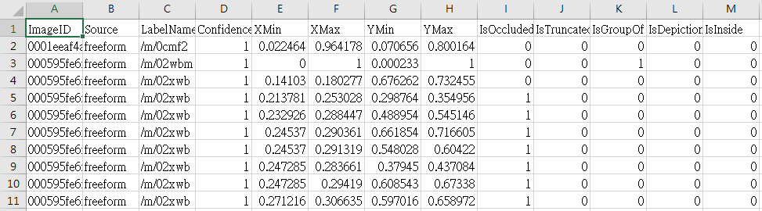
How to download dataset – Download (2/3)
Download bounding box annotations:
https://storage.googleapis.com/openimages/web/download.html
Annotation is in csv file format. The bounding box information is descripted in the file.

Slide 11
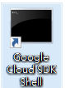
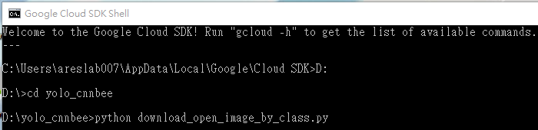
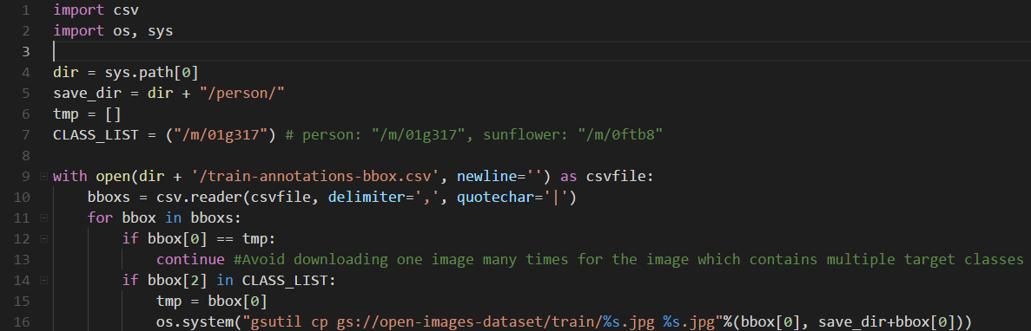
How to download dataset – Download (3/3)
Download images:
Execute download script in Google Cloud SDK Shell.
Use Linux like command line API to copy images from CVDF’s cloud to your computer.
Codes at: https://github.com/Spiritator/machine-learning-dataset-tool
Reference: https://github.com/cvdfoundation/open-images-dataset/issues/8

Slide 12
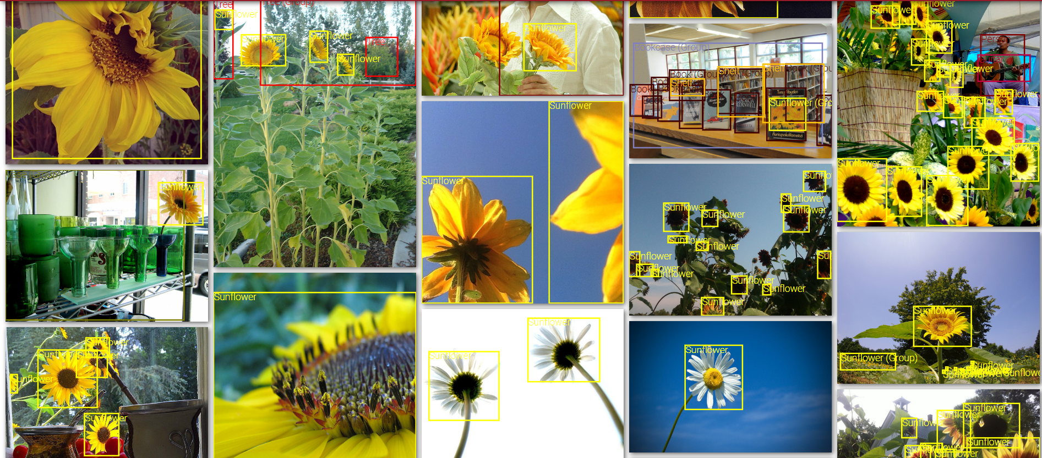
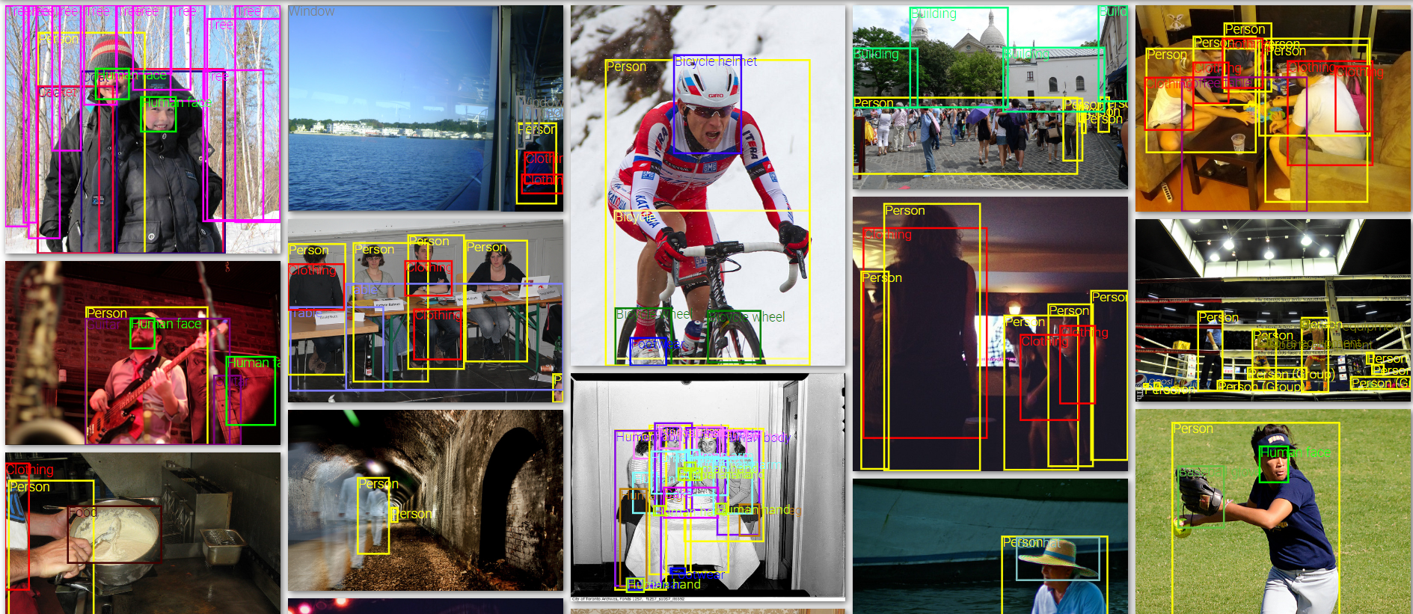
Training
Two classes (sunflower , person) of good variety images downloaded from open image dataset.
Class : sunflower
1595 images
6870 bounding boxes
Class : person
5530 images
23379 bounding boxes

Slide 13
Training
You may encounter bounding box annotation format issue.
Here are some of my conversion example.
https://github.com/Spiritator/machine-learning-dataset-tool
Takes around 3 hours to train Full-YOLO network on server.
Takes around 2.5 hours to train Tiny-YOLO network on server.

Slide 14
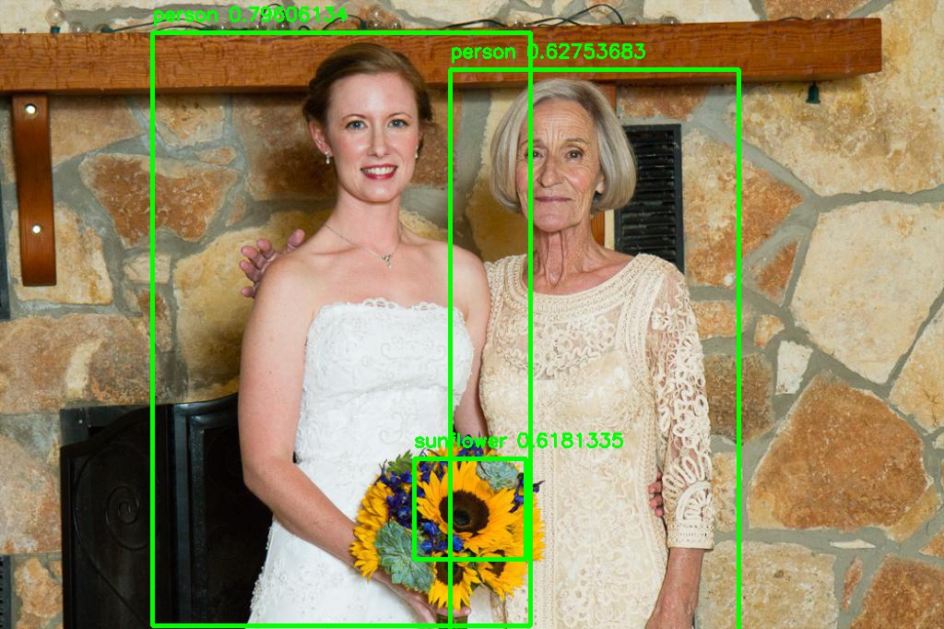
Test Result

Slide 15
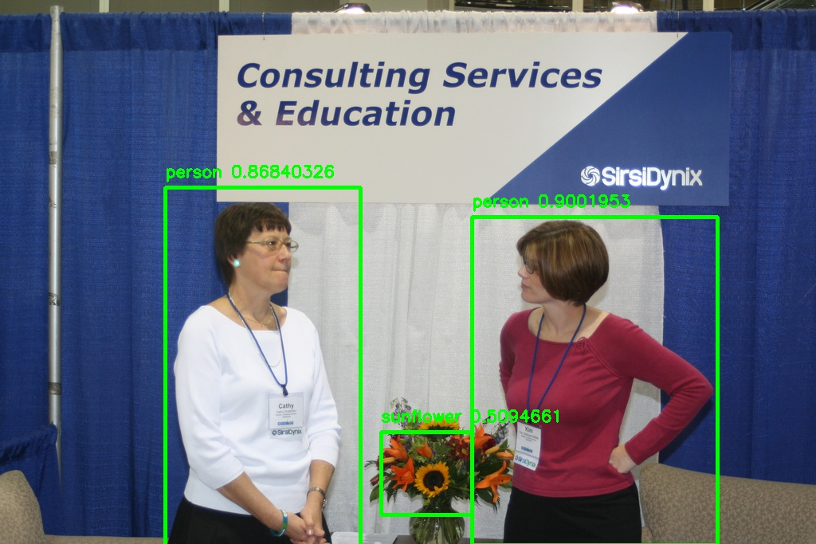
Test Result

Slide 16
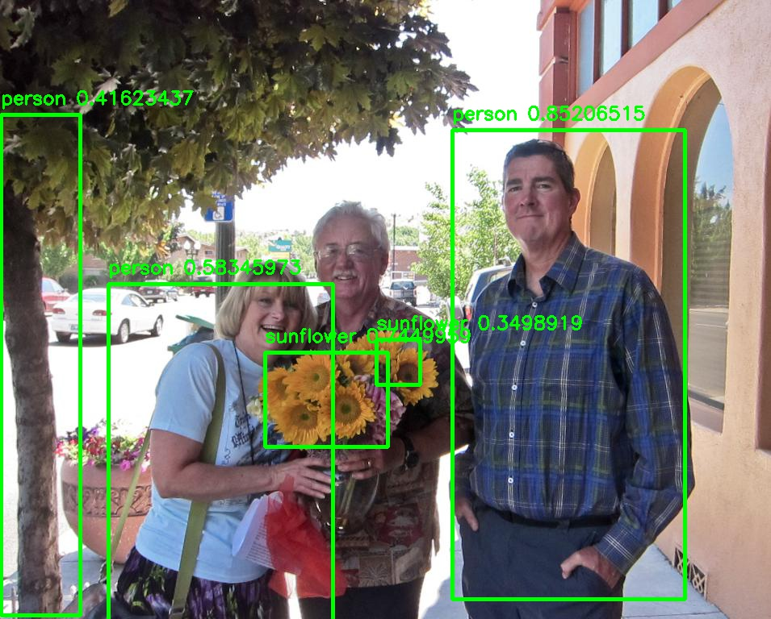
Test Result

Slide 17
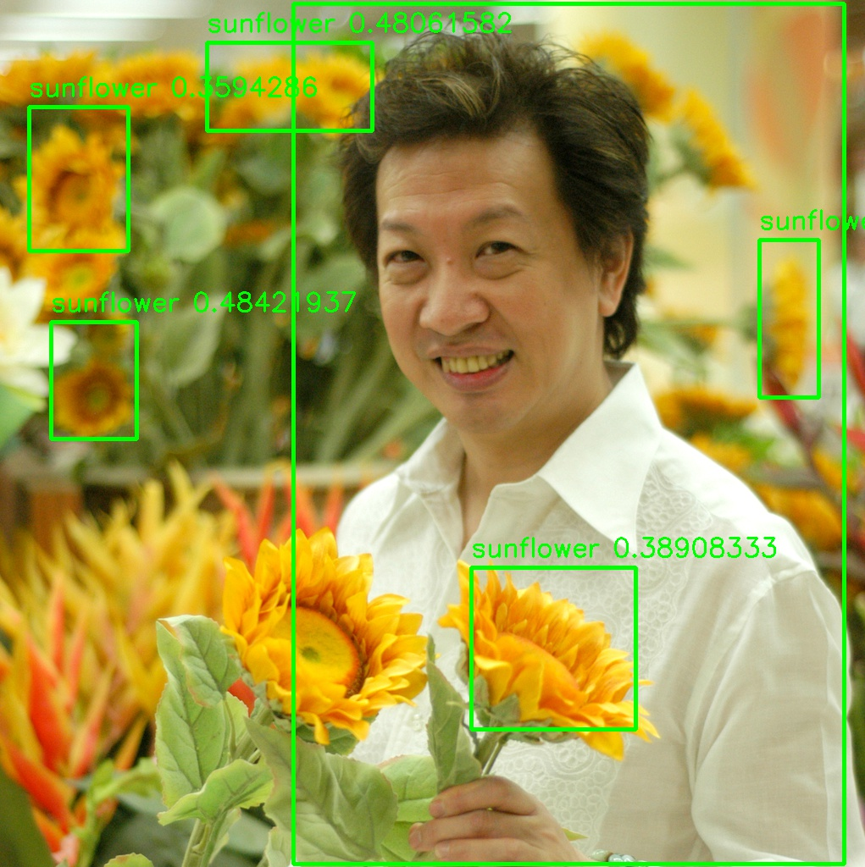
Test Result

Slide 18
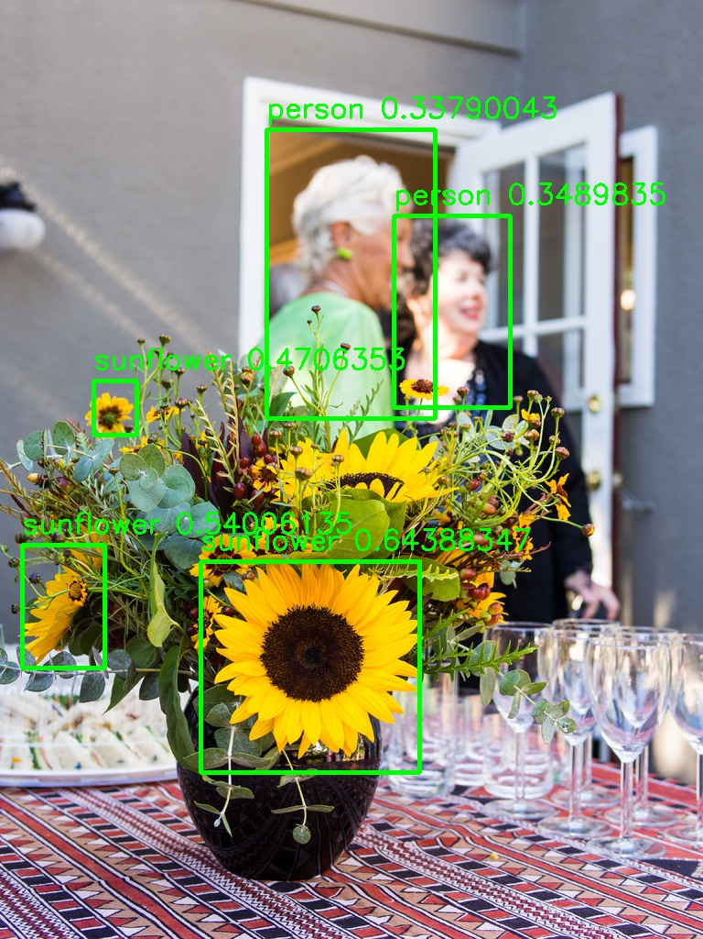
Test Result

Slide 19
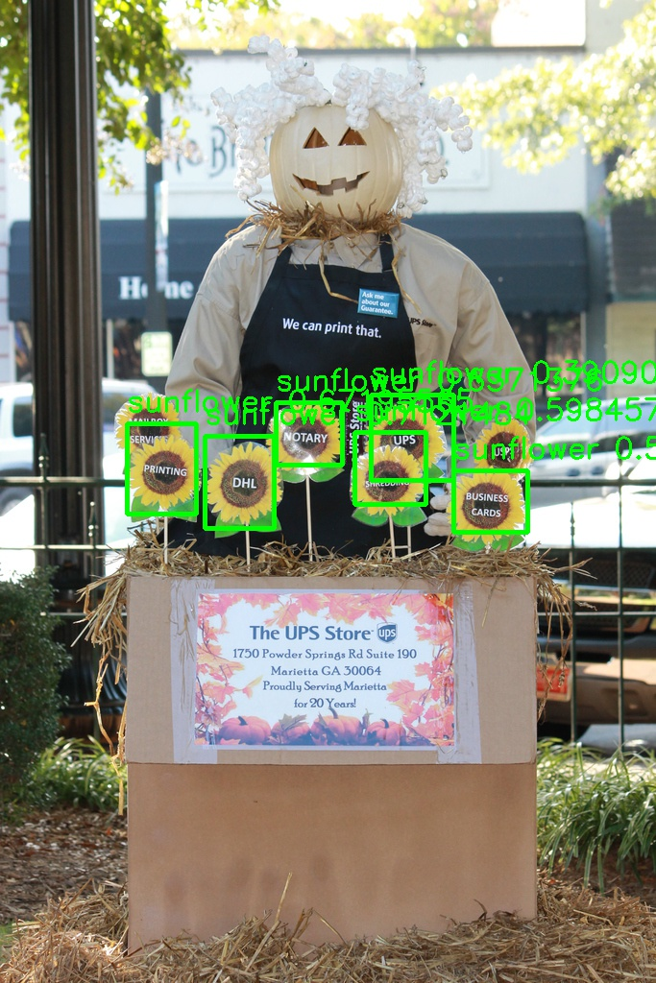
Test Result

Slide 20
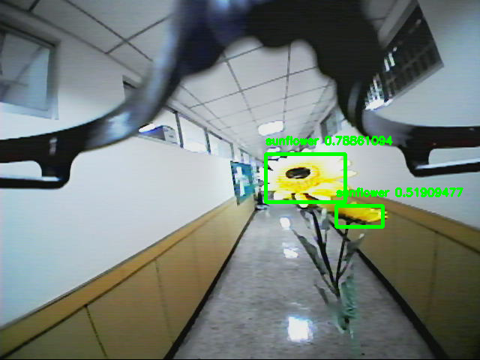
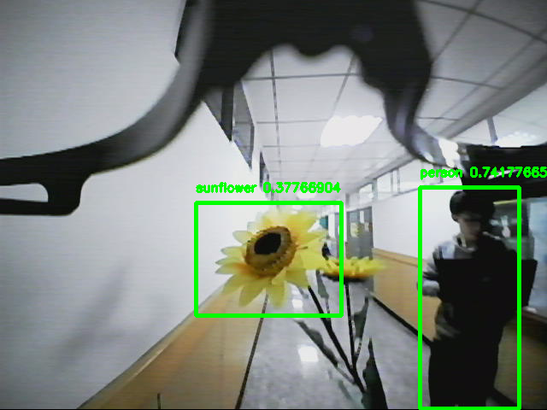
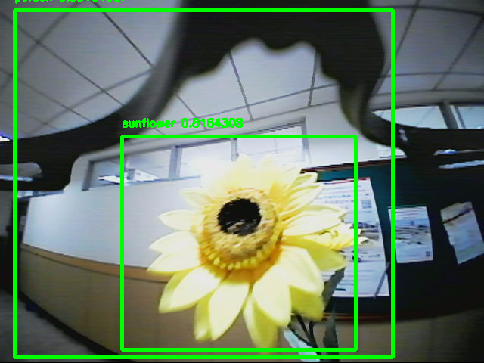
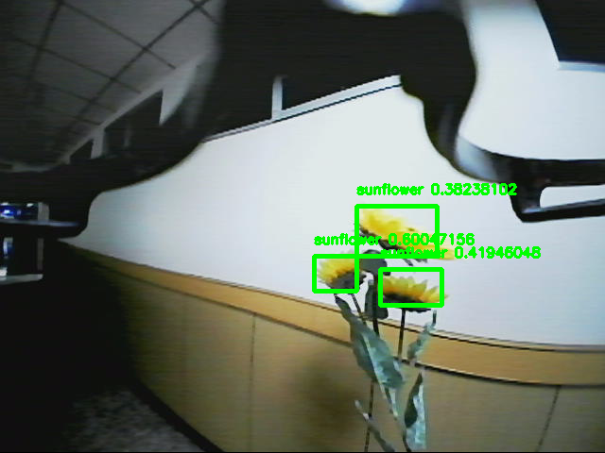
Test Result

Slide 21
Test Result
Real Time Testing
Device
CPU: i7-6700HQ
GPU: GTX 1060 3GB
Result
Full YOLO: 19fps @ 640x480 resolution
Tiny YOLO: 30fps @ 640x480 resolution

